Slide 1
BEST PRACTISE Microsoft Power Platform
Tc. Mohd Amirol Bin Ahmad
Sr. Software Engineer

Slide 2
Why?
Boost the
PERFORMANCE
Ref (1): Tips and best practices to improve performance of canvas apps - Power Apps | Microsoft Learn
Ref (2): Common canvas apps performance issues and resolutions - Power Apps | Microsoft Learn

Slide 3
Limit data connections
DON’T add more than 30 connections in one app.
Apps prompt new users to sign into each connector, so every extra connector increases the amount of time that the app needs to start. As an app runs, each connector requires CPU resources, memory, and network bandwidth when the app requests data from that source.

Slide 4
Limit the number of controls
DON’T add more than 500 controls in one app.
Power Apps generates an HTML document object model to render each control. The more controls you add, the more generation time Power Apps needs.

Slide 5
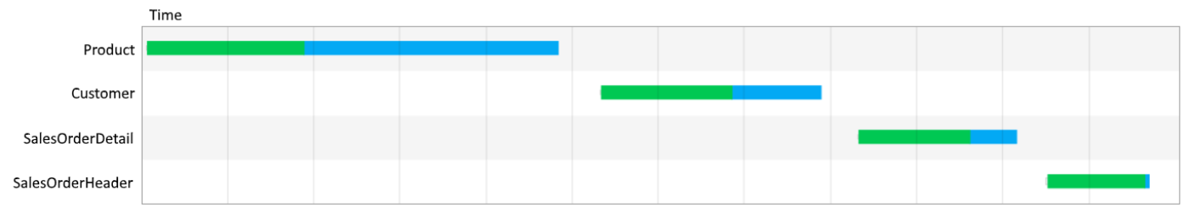
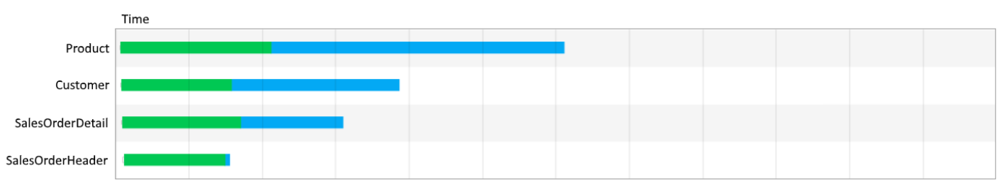
Optimize the OnStart property
Use the ClearCollect function to cache data locally if it doesn't change during the user session. Also, use the Concurrent function to load data sources simultaneously; this can cut the amount of time an app needs to load data in half.
ClearCollect( Product, '[SalesLT].[Product]' );
ClearCollect( Customer, '[SalesLT].[Customer]' );
ClearCollect( SalesOrderDetail, '[SalesLT].[SalesOrderDetail]' );
ClearCollect( SalesOrderHeader, '[SalesLT].[SalesOrderHeader]' )
Concurrent(
ClearCollect( Product, '[SalesLT].[Product]’ ),
ClearCollect( Customer, '[SalesLT].[Customer]’ ),
ClearCollect( SalesOrderDetail, '[SalesLT].[SalesOrderDetail]’ ),
ClearCollect( SalesOrderHeader, '[SalesLT].[SalesOrderHeader]’ )
)

Slide 6
Cache lookup data
Use the Set function to cache data from lookup tables locally to avoid repeatedly retrieving data from the source. This technique optimizes performance if the data probably won't change during a session. As shown in the following example, the data is retrieved from the source once, and then referenced locally until the user closes the app.
Set(CustomerOrder, Lookup(Order, id = “123-45-6789”));
Set(CustomerName, CustomerOrder.Name);
Set(CustomerAddress, CustomerOrder.Address);
Set(CustomerEmail, CustomerOrder.Email);
Set(CustomerPhone, CustomerOrder.Phone);

Slide 7
Limit the number of controls
Avoid repeating the same formula in multiple places
If multiple properties run the same formula (especially if it's complex), consider setting it once and then referencing the output of the first property in subsequent ones. For example, don't set the DisplayMode property of controls A, B, C, D, and E to the same complex formula.
Instead, set A's DisplayMode property to the complex formula, set B's DisplayMode property to the result of A's DisplayMode property, and so on for C, D, and E.

Slide 8
Limit the number of controls
Enable DelayOutput on all Text input controls
If you have multiple formulas or rules that reference the value of a Text input control, set the DelayedOutput property of that control to true. The Text property of that control will be updated only after keystrokes entered in quick succession have stopped. The formulas or rules won't run as many times, and app performance will improve.

Slide 9
Limit the number of controls
Avoid using Form.Updates in rules and formulas
If you reference a user-input value in a rule or a formula by using a Form.Updates variable, it iterates over all the form's data cards and creates a record each time. To make your app more efficient, reference the value directly from the data card or the control

Slide 10
Limit the number of controls
Use DelayItemLoading and Loading spinner to improve performance in Gallery
Simplify the template. For example, consider reducing the number of controls, references to lookups.
Galleries with complex templates can benefit from having DelayItemLoading set to true, and LoadingSpinner set to LoadingSpinner.Controls. This change will improve the perceived experience when render time is longer. DelayItemLoading will also defer the rendering of templates which will allow the rest of the screen to render faster as both screen and gallery are not competing for resources.

Slide 11
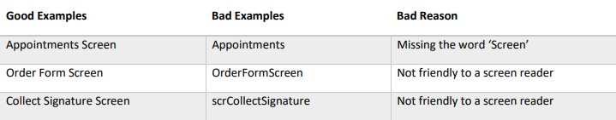
Naming Conventions
Screen Names
Screen name should clearly describe its purpose in 2-3 words ending with word “Screen.” Use proper-case. A screen reader will speak the screen name to visually-impaired users when the screen loads.

Slide 12
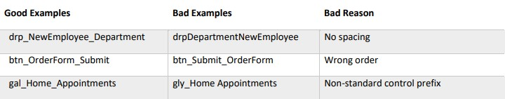
Naming Conventions
Control Names
A control name should show the control-type, the purpose and the screen. Use camel-case and underscores for spacing. For example, the control named txt_OrderForm_FirstName is a text input that captures first name on the app’s Order Form Screen.

Slide 13
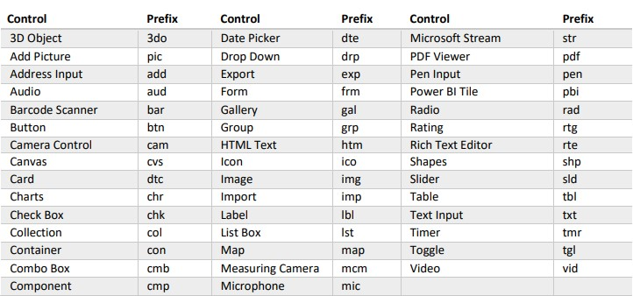

Slide 14
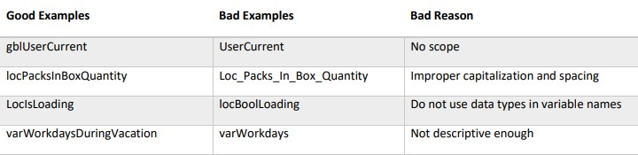
Naming Conventions
Variable Names
A variable name should show the scope of the variable and its purpose. Use camel-case with no spaces between each word. For example, the variable gblUserEmail is a global variable which holds the current user’s email address.

Slide 15
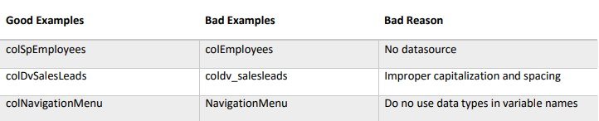
Naming Conventions
Collection Names
A collection name should contain the original datasource and describe its purpose. Use camel-case with no spaces between each word. For example, the collection colDvInvoices is a collection of invoices from Dataverse.

Slide 16
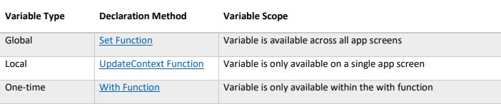
Variable Type Standards
Variable Scope
A variable’s scope determines where it can be referenced in the app. If the variable is required on multiple screens use a global variable. Otherwise, use a local or context variable instead. Choose the proper variable type by determining its scope.
Notes:
Why Use Both Local Variables And Global Variables Imagine a large canvas app with many screens that only uses global variables. When updating a variable’s value the developer must be aware of its impact across all screens. If the developer does not correctly determine how to use a variable there are unintended consequences (i.e. a software bug). Local variables can only be used on one screen. Developers have an easier time assessing the impact to a single screen as opposed to many screens. Higher quality code can be written at a faster pace. One-time variables are not persistently stored in memory. After the With function is executed the variable is cleared from memory and cannot be accessed outside of the function.

Slide 17
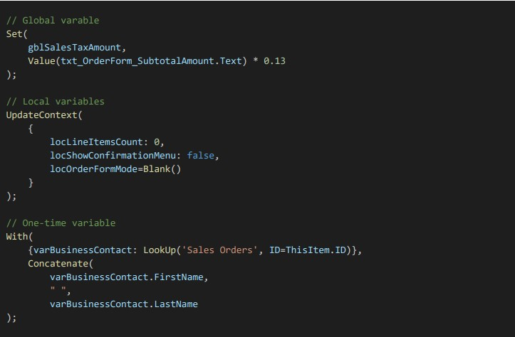

Slide 18

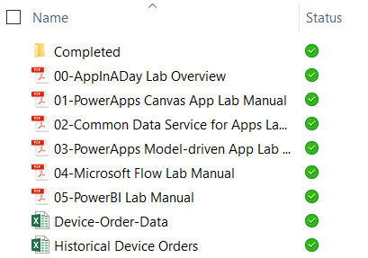
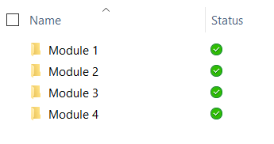
Lab content
Package: https://bit.ly/3lBFEkA
Unzip the package on your local machine
Follow instructions: “01 - Create A Machine Ordering Power Apps Canvas App”
Lab docs:
Contains 4 modules with a lab doc for each:
01 - Create a machine ordering Power Apps canvas app
02 - Create a Dataverse table for the machine ordering app
03 - Create a model-driven Power Apps app for machine ordering
04 - Integrate a Power Apps app with Power Automate
Completed modules:

Slide 19
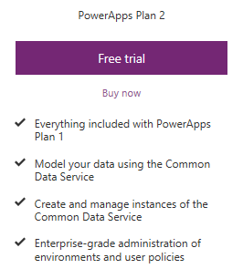
Pre-requisites
Valid Power Apps license:
Dataverse usage requires a Power Apps license
Visit https://powerapps.microsoft.com/pricing/ and click Free Trial
If you are unable to acquire a trial license: Ask the instructor for a trial user account that you may use for this session OR Create your own Office 365 trial tenant – http://aka.ms/Office365E5Trial
Power Apps authoring environment:
Launch https://make.powerapps.com using any modern browser
Power Apps mobile apps (Optional):
PowerApps – iOS : https://aka.ms/PowerAppsiOS PowerApps – Android : https://aka.ms/PowerAppsAndroid

Slide 20
Provision environment and Dataverse
This lab requires a new Power Apps environment and database that was provisioned for this class
Go to the Power Apps Admin center – http://aka.ms/ppac
Select +New environment, fill out the form using a Trial Environment, and select Create Environment
Select the Create database option
Fill out the form, check the box to include sample apps and data and select Create my database
Your new environment will be added to the list of environments
IMPORTANT: The database has not yet been provisioned
Select the environment you just created
Wait for the “Provisioning database…” message to go away
You may need to refresh the screen every couple of minutes
Once the provisioning is complete, then proceed to create apps in the environment
Notes:
Please review instruction manual 00 for details.

Slide 21
Hands-on-lab 1
Module 1: Power Apps Canvas App

Slide 22
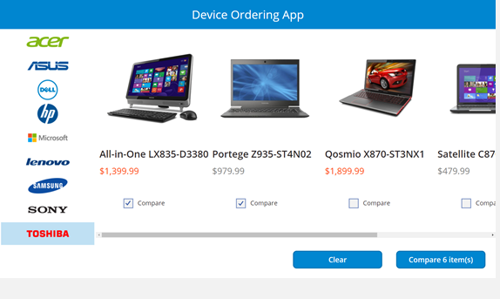
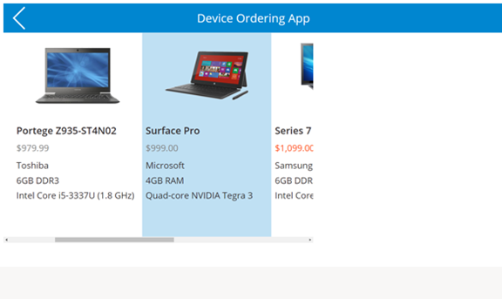
Module 1:Learning objectives
Canvas App
Dataverse
Model- driven
App
Power Automate
Sign-in and create a new Canvas App
Connect to data sources
Filter data
Work with multiple screens and navigation
Customize the user experience – galleries and controls

